Slide 1



GuardRails
A Data-Centric Web Application Security Framework
Jonathan Burket, Patrick Mutchler, Michael Weaver,
Muzzammil Zaveri, and David Evans
University of Virginia
http://guardrails.cs.virginia.edu

Slide 2




Web applications are easier to create
than ever!

Slide 3

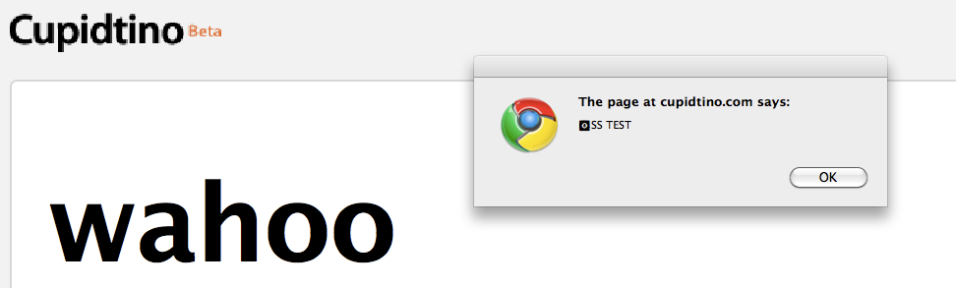


Securing web applications is
not nearly as easy!
Notes:
With web applications being produced left and write specially thanks to modern day web application frameworks its easier than ever.

Slide 4
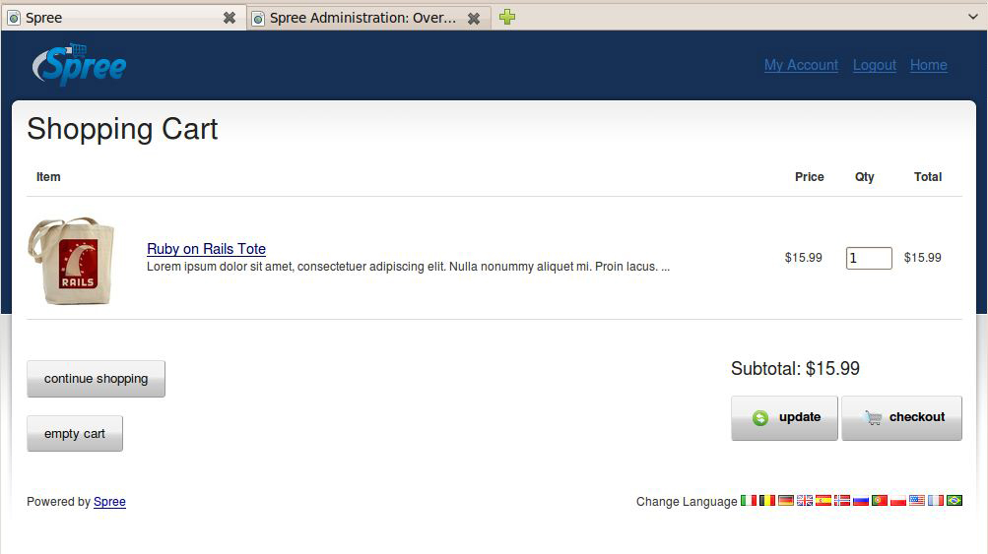

Slide 5
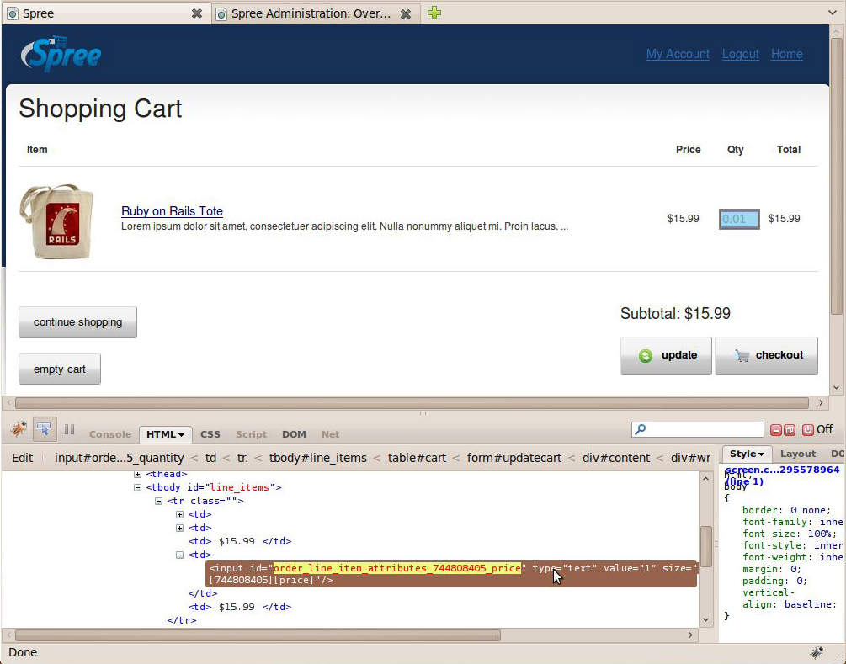

Slide 6
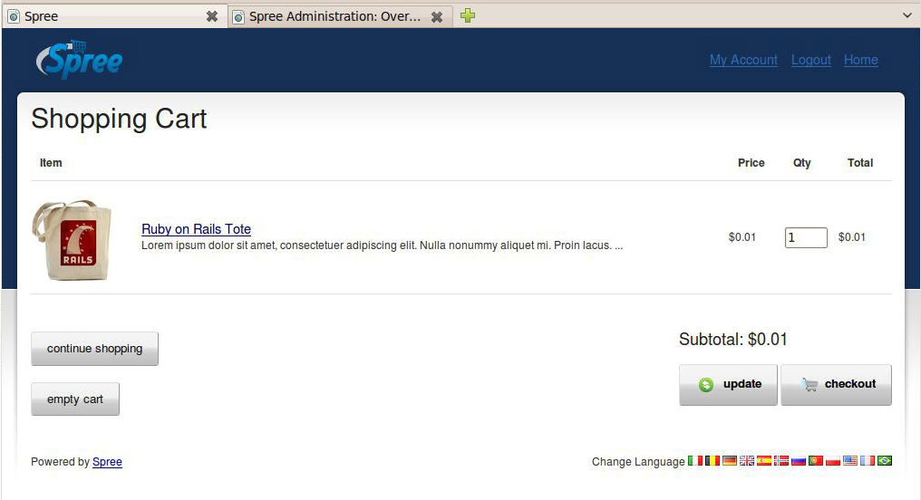

Slide 7
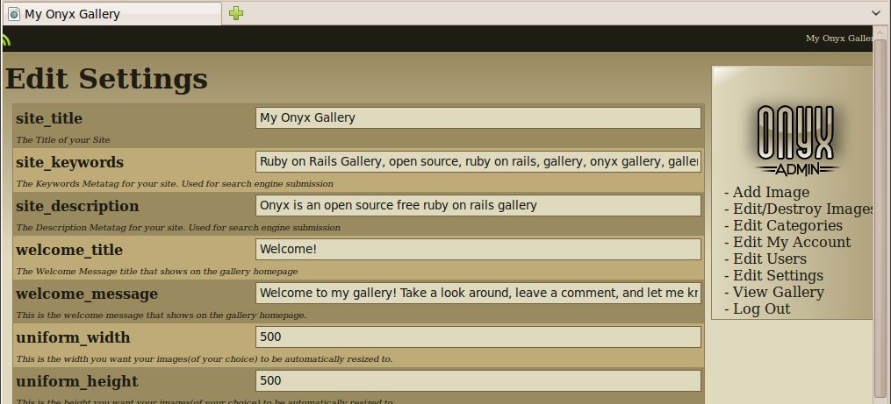
“><script>alert(document.cookie);</script>

Slide 8
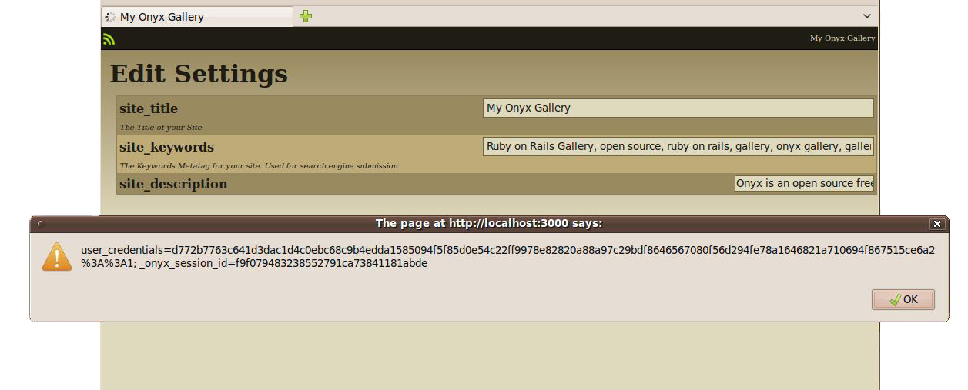

Slide 9
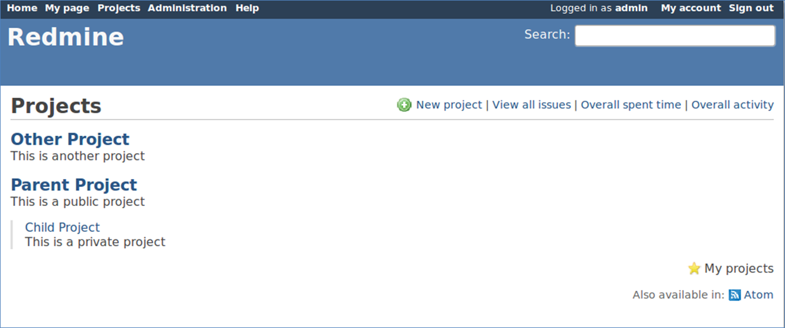

Slide 10
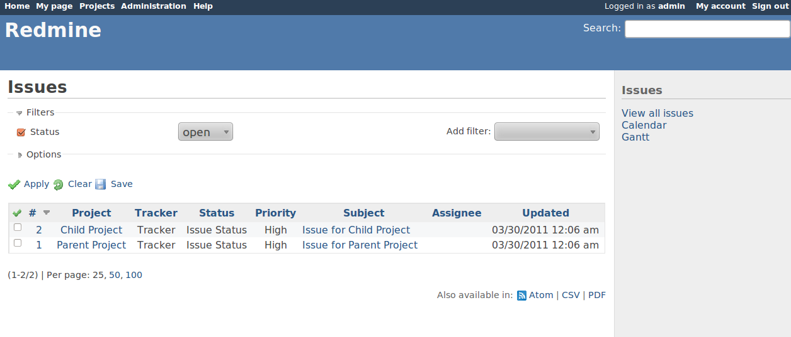

Slide 11
Application
Page A
Write
Page B
Append
Read
Data Object
Write
Read
Page C
Delete
Read
Read
Page D

Slide 12
Application
Page A
Write
Page B
Append
Output HTML
Read
Data Object
Write
Read
Data Object
Page C
Delete
Read
Read
Page D

Slide 13
Application
Page A
Write
Page B
Append
Output HTML
Data Object
Read
Data Object
Write
Read
Page C
Delete
Read
Read
Page D

Slide 14
Application
Page A
Write
Page B
Append
Read
Data Object
Write
Read
Page C
Delete
Read
Read
Page D
Proxy that Enforces
Security Policies

Slide 15
Application
Page A
Write
Page B
Append
Output HTML
Read
Data Object
Write
Read
Data Object
Page C
Delete
Read
Read
Page D
Proxy that Enforces
Security Policies

Slide 16

Our Philosophy
Security policies should be attached to the data
Security policies should be enforced automatically

Slide 17
Annotated Ruby on Rails Code
Secure Ruby on Rails Code
GuardRails
Prevent Bugs and Security Vulnerabilities
Improve Readability
Easy to Use
Access Control Policies
Fine Grained Taint-Tracking
Notes:
A source-to-source tool for Ruby on Rails applications
Secures application by enforcing data-level security policies
Target data sanitization and access control policies

Slide 18
Design Goals
Top Priority:
Automatically enforce security policies
Other Objectives:
Preserve application functionality
Easy for developers to use
Lesser Goals:
Minimize performance cost

Slide 19
Annotated Ruby on Rails Code
Secure Ruby on Rails Code
GuardRails
Prevent Bugs and Security Vulnerabilities
Improve Readability
Easy to Use
Access Control Policies
Fine Grained Taint-Tracking
Notes:
A source-to-source tool for Ruby on Rails applications
Secures application by enforcing data-level security policies
Target data sanitization and access control policies

Slide 20
Annotated Ruby on Rails Code
Secure Ruby on Rails Code
GuardRails
Prevent Bugs and Security Vulnerabilities
Improve Readability
Easy to Use
Access Control Policies
Fine Grained Taint-Tracking
Notes:
A source-to-source tool for Ruby on Rails applications
Secures application by enforcing data-level security policies
Target data sanitization and access control policies

Slide 22

if include_subprojects && !active_children.empty? ids = [id] + active_children.collect {|c| c.id}
conditions = ["#{Project.table_name}.id IN (#{ids.join(',')})"]
Notes:
*Add original redmine code with long code and fix the code over several slides

Slide 23
if include_subprojects && !active_children.empty? ids = [id] + active_children.collect {|c| c.id}
conditions = ["#{Project.table_name}.id IN (#{ids.join(',')})"]
Notes:
*Add original redmine code with long code and fix the code over several slides

Slide 24
if include_subprojects && !active_children.empty? ids = [id] + active_children.collect {|c| c.id}
conditions = ["#{Project.table_name}.id IN (#{ids.join(',')}) AND
#{Project.visible_by}"]
Notes:
*Add original redmine code with long code and fix the code over several slides

Slide 25
application_helper.rb
4 Checks
1 GuardRails Annotation
# @ :read, :self,
lambda{|user|self.is_public
or user.memberships.include? self.id}
project.rb
2 Checks
projects_controller.rb
In Project model file:
3 Checks
# @ :read, lambda{|user| self.is_public
or user.memberships.include? self.id}
class Project < ActiveRecord::Base
# Project statuses
STATUS_ACTIVE = 1…
acts_as_searchable.rb
1 Checks
Notes:
Application_helper -> 4
Project -> 2
Projects_controller -> 3
Acts_as_searchable.rb -> 1

Slide 26
Access Control Policy Annotations
# @ (policy_type, [target], [handler], mediator)
# @ :delete, :self, :admin
# @ :write, :password, lambda{|user|user.id == self.id }
# @ :append, :members, lambda{|user| user.belongs_to?(self)}

Slide 27
Annotated Ruby on Rails Code
Secure Ruby on Rails Code
GuardRails
Access Control Policies
Fine Grained Taint-Tracking
Notes:
A source-to-source tool for Ruby on Rails applications
Secures application by enforcing data-level security policies
Target data sanitization and access control policies

Slide 28
Dynamic Taint Tracking
Protects against injection attacks
SQL Injection:
“SELECT profile FROM users WHERE username=‘” + user_name + “’”
Good: user_name = “jazzFan26”
Bad: user_name = “’; DROP TABLE users--”
Cross-Site Scripting:
“User: <a href=‘profile_page’>” + user_name + “</a>”
Good: user_name = “DrKevinPhillips”
Bad: user_name = “<script language=‘javascript’>
alert(‘document.cookie’);</script>”

Slide 30
Application
Page A
Write
Page B
Append
Read
Data Object
Write
Read
Page C
Delete
Read
Read
Page D

Slide 31
Application
Page A
Write
Page B
Append
Output HTML
Read
Data Object
Write
Read
Data Object
Page C
Delete
Read
Read
Page D

Slide 32
Taint Propagation
URL Parameters
Controller
Model
Form Data
Other User Input
View
Database
Tainted HTML
Data
Taint
Status
Safe HTML
Sanitization
Notes:
*Make this show the taint flow (like the picture in StringStuff2.odt)
*keep the foo-bar example
Cite DBTaint?

Slide 33
Expressive Taint Status
“<a href=‘profile?id=184392’><evil>SoccerFan1985</evil></a>”
String
Value:
“<a href=“profile?id=184392”><evil>SoccerFan1985</evil></a>”
Taint:
29
<Transformer::Identity>
51
<Transformer::Default>
Different
Chunks
55
<Transformer::Identity>
Character
Index

Slide 34

Transformers
Use Context
The Default Transformer
{:HTML => {
“//script” => NoDisplay,
:default => NoHTMLAllowed
},
:SQL => SQLSanitize,
:Ruby_eval => NoDisplay}
Appropriate Sanitization Routine

Slide 35
Transformers
Use Context
Raw String Chunk 1
Transformer 1
Sanitized Chunk
Raw String Chunk 2
Transformer 2
Sanitized Chunk
Raw String Chunk 3
Transformer 3
Sanitized Chunk
Sanitized String

Slide 36
Transformer Annotations
# @ taint, target, transformer
# @ :taint, :username,
  {:HTML => AlphaNumericOnly}
# @ :taint, :full_name,
  {:HTML =>
  {TitleTag => LettersAndSpacesOnly,
  :default => NoHTML}}
# @ :taint, :profile,
  {:HTML => {"//script” => Invisible,
  :default => BoldItalicUnderlineOnly}}
Different sanitization policies in different contexts
Context specified with XPath
Notes:
*Work on this one
Add sample context-sensitive annotations
Example of situations of different context

Slide 37
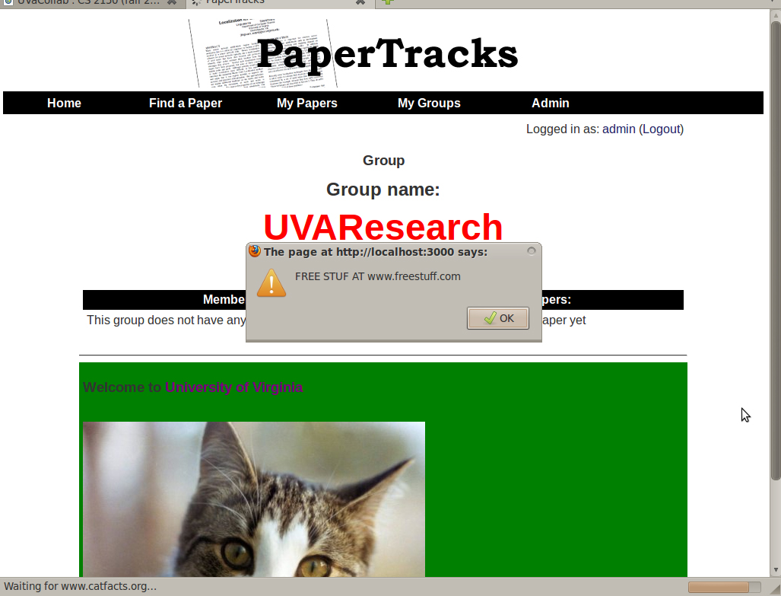
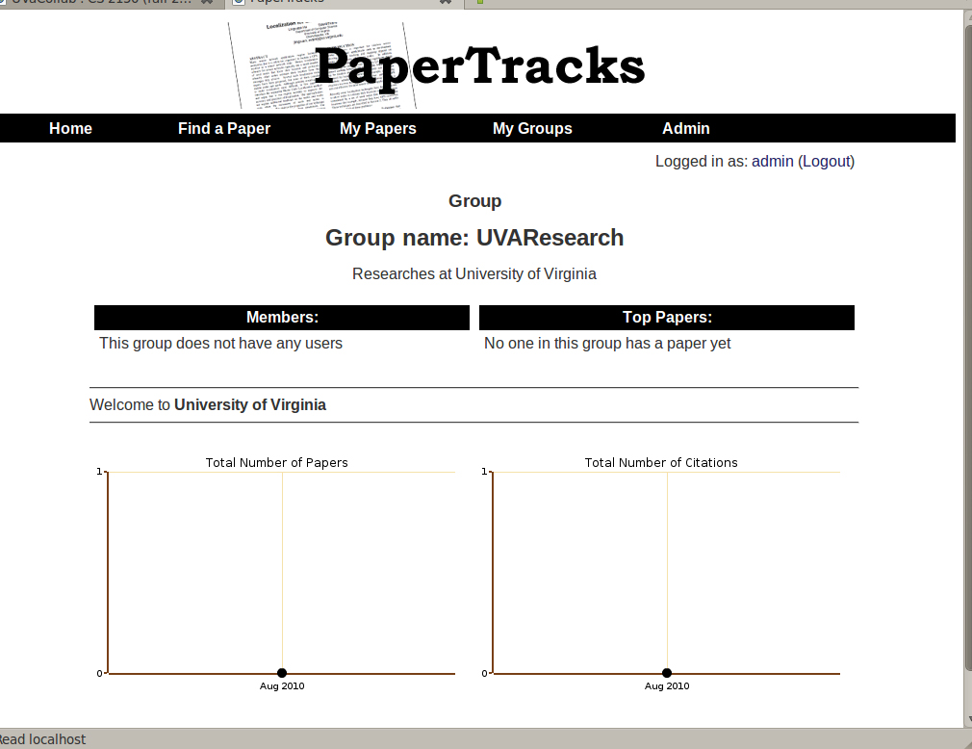

Slide 39


Slide 40



Test Application | Application Type
 | Image Gallery (680 lines)
 | E-Commerce (5556 lines)
 | Project Management (30747 lines)
 | E-Commerce (11561 lines)

Slide 41
Performance Notes

Slide 42
Try GuardRails
Alpha Release Now Available!
Our Web Page: http://guardrails.cs.virginia.edu
Full source code can be downloaded from GitHub
Contact Info: guardrails@cs.virginia.edu

Slide 43
Questions?
Alpha Release Now Available!
Our Web Page: http://guardrails.cs.virginia.edu
Full source code can be downloaded from GitHub
Contact Info: guardrails@cs.virginia.edu
Notes:
Maybe make design goals slide (including things like that the annotations should not break the original application) (maybe specify performance as not a primary goal too)

