Slide 1
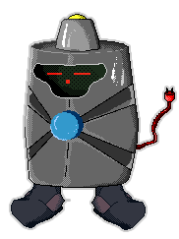
PicoCTF: Inspiring Tomorrow’s Cyber Security Workforce and Leaders
Jonathan Burket
jburket@cmu.edu

Slide 2
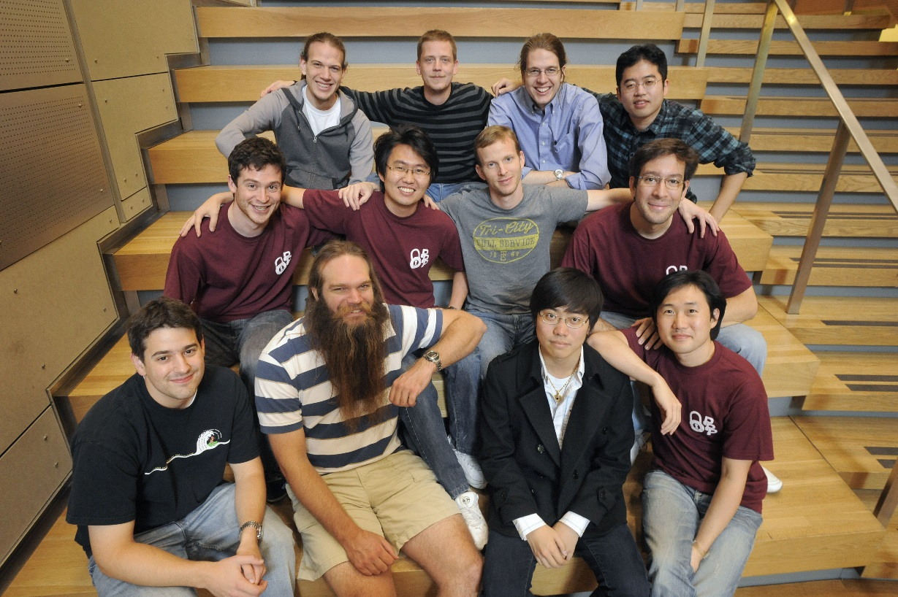
Plaid Parliament of Pwning
Old Picture!
Computer Security Research Group
Undergraduates, Graduate Students, and Staff
Primarily Play in Capture-the-Flag Competitions
Primarily Play in Capture-the-Flag Competitions

Slide 3
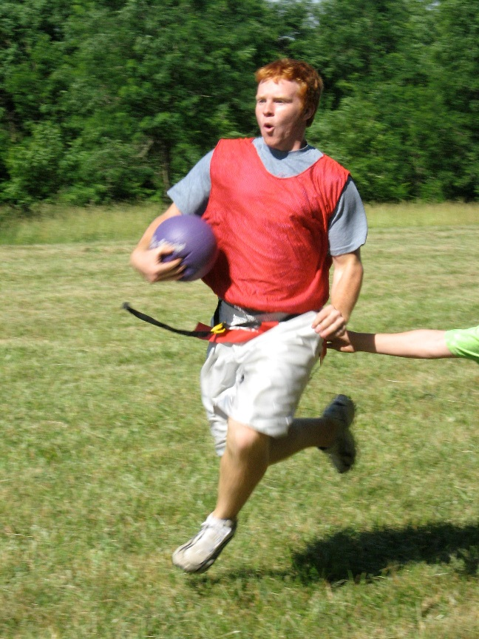
Capture the Flag Competitions
CTFs
Digital
[1]
Open-Ended and Difficult

Slide 4
CTF Competitions
Cryptography
Digital Forensics
Reverse Engineering
Binary Exploitation
Web Security

Slide 5
Goals
An authentic, fun, and interactive hacking experience for high school students.
Encourage students to pursue degrees of computer science, regardless of incoming background.
Nationally recognize and inspire top competitors to become industry leaders.

Slide 6
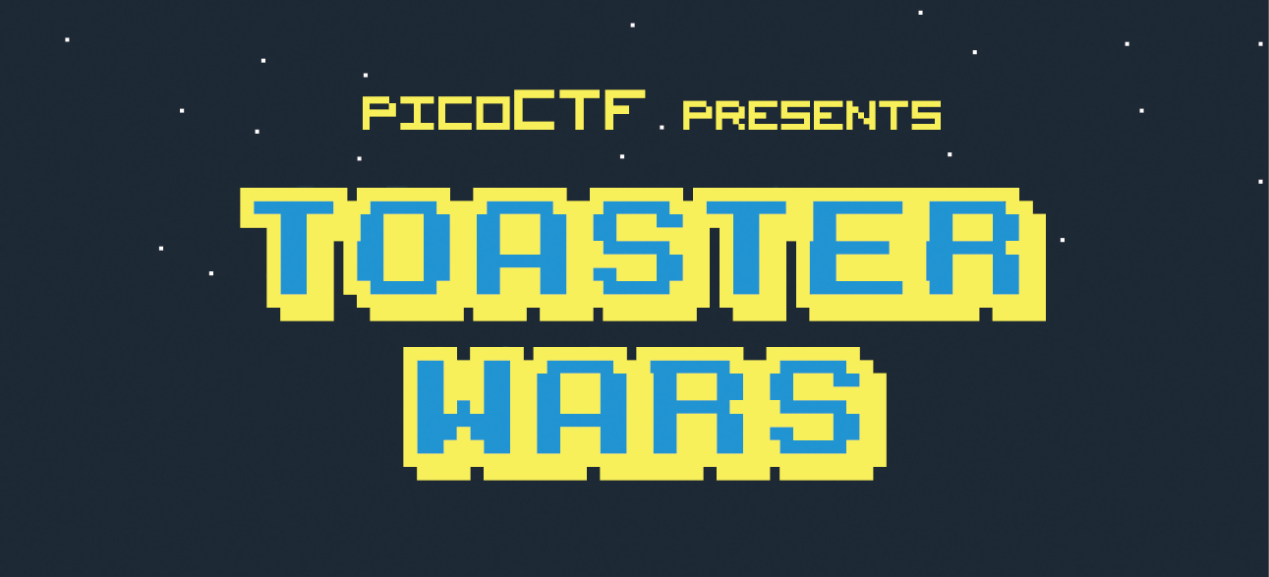
April 26 7:00 AM EDT - May 6 11:59 PM EDT
A polished presentation to welcome students and add legitimacy.

Slide 7
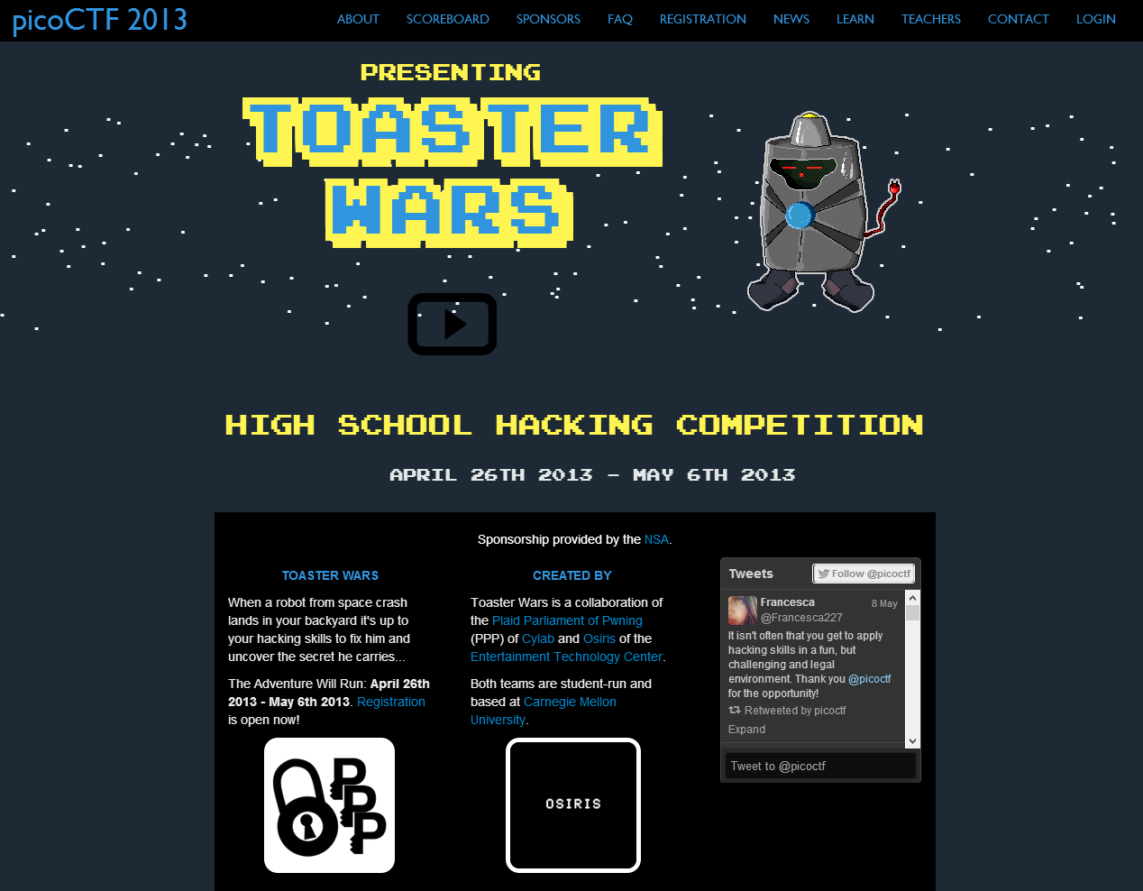

Slide 8
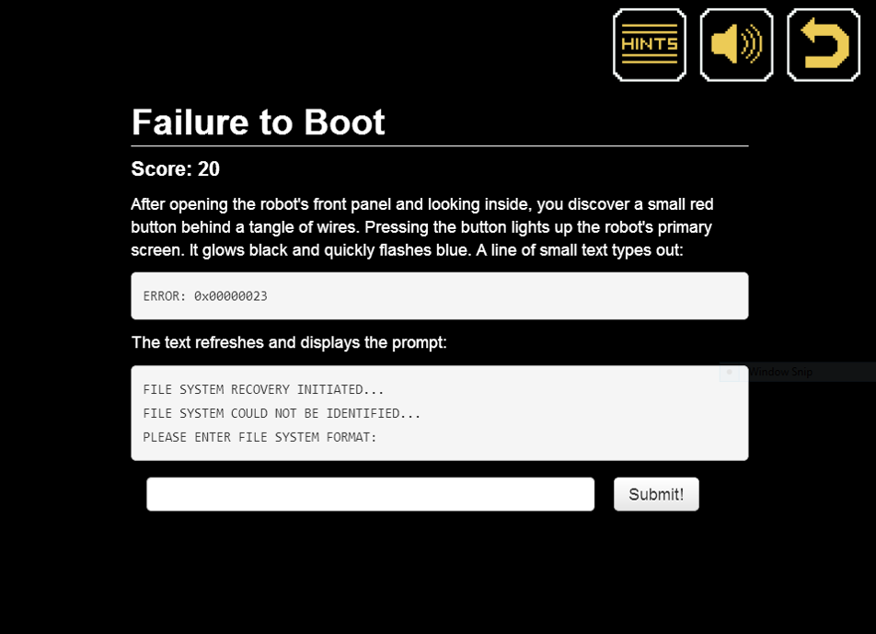
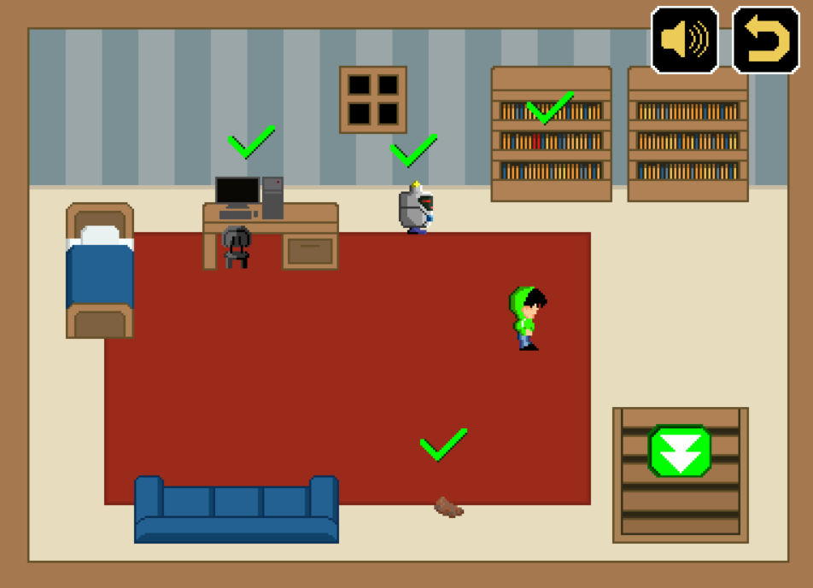

Slide 9
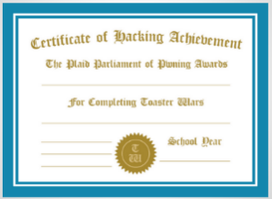
Competition Organization
Level 1
Level 2
Level 3
Level 4
No programming experience necessary,
computer know-how useful
Basic programming experience
AP Computer Science
Hard. Very hard.
Each skill level can finish with accomplishment.

Slide 10
Eligibility
Anyone can play!
Winners must be:
Attending school in the United States
A 6th to 12th grade student
On a team of 5 or fewer eligible players

Slide 11
Prizes
 | Cash | AWS Credit | Wiley Books
1st Place School | $8,000 | $250 | 7 Books
2nd Place School | $4,000 | $250 | 5 Books
3rd Place School | $2,000 | $250 | 3 Books
1st Place Team | $4,000 | $1,000 | 7 Books
2nd Place Team | $2,000 | $250 | 5 Books
3rd Place Team | $1,000 | $250 | 3 Books
Winning teams also received trophies, t-shirts, and certificates

Slide 12
How did it go?

Slide 13
Success!
2,589 Registered Teams
1,938 Participated
172,482 Submissions
47,229 Unique Visitors
558,080 Pageviews
1,785,384 Logged Events
8-10,000 Students
One of the largest computer security competitions ever held.

Slide 14
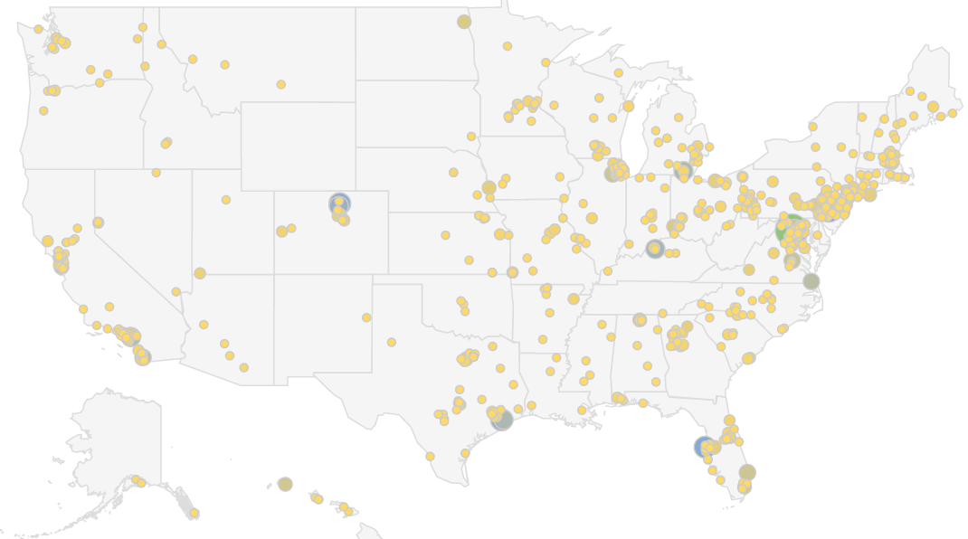
Affiliations
955 different schools.

Slide 15
It was great. I'm gonna use the challenges that are still open
to teach people things at my school's computer science club.
I loved the contest. It was really amazing.
Thank you very much. This program has taught me more than I ever would have imagined.
CTF was really fun for first time CTF-ers.
We will definitely do this or something like this again
I enjoyed this competition because it was unlike anything I had ever done before
This was really awesome, I learned a whole lot, had fun, and I hope you guys do this next year.
We will definitely be competing again next year!
It was a great experience! Thank you for taking the time to set this up!
I just really loved picoCTF and I really think you guys should have it again.
Thanks you guys so much for doing this. All the other security competitions aimed at high schoolers are terrible.
I loved the competition! Thank you so much for this it taught me so much!
Keep doing this! I loved it! The challenges were creative and thought-provoking.

Slide 16
Impact and Observations

Slide 17
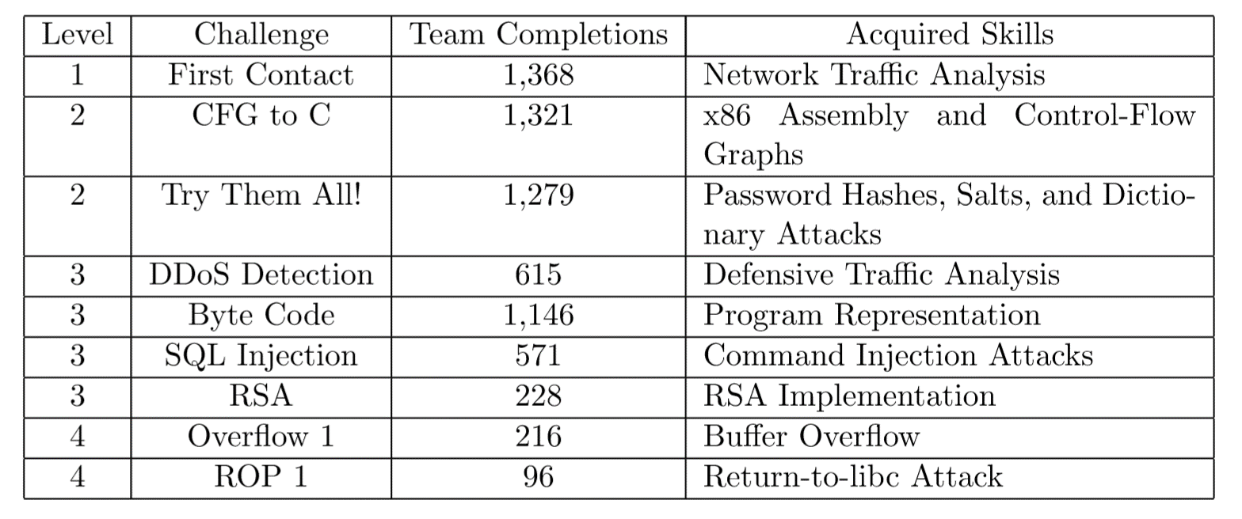
Educational Impact
A non-trivial exercise for graduate students

Slide 18
Educational Impact
Compared to typical course work, how much do you think you learned?

Slide 19
Takeaways – Want More Of:

Slide 20
Takeaways – Want Fewer Of:

Slide 21
Game Viewer Usage

Slide 22
Game Viewer Usage

Slide 23
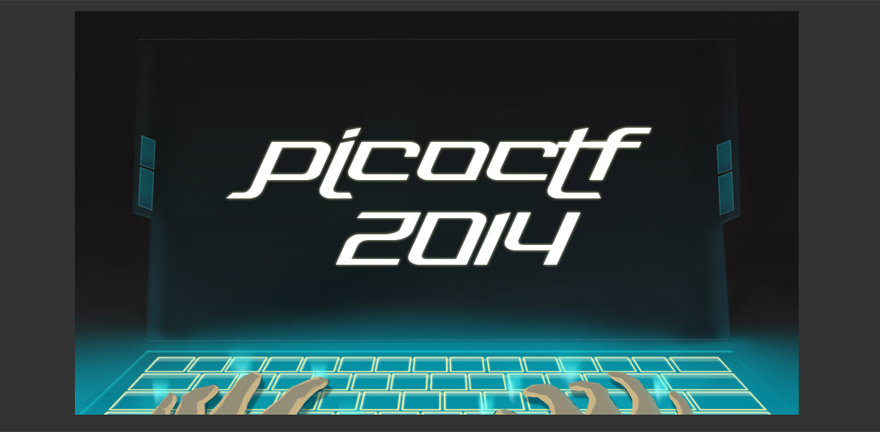
Coming this Fall (Probably October)

Slide 24
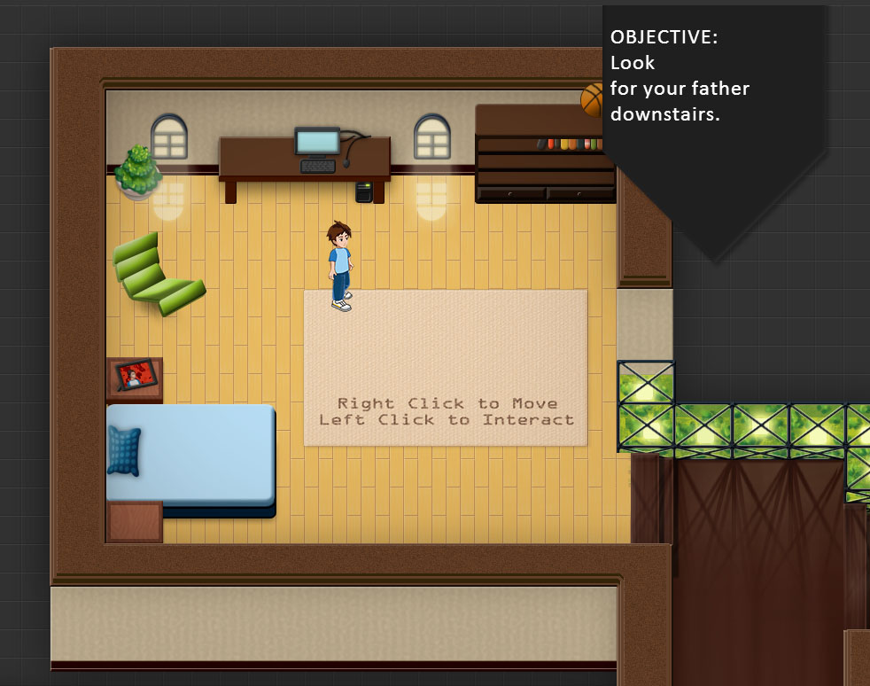
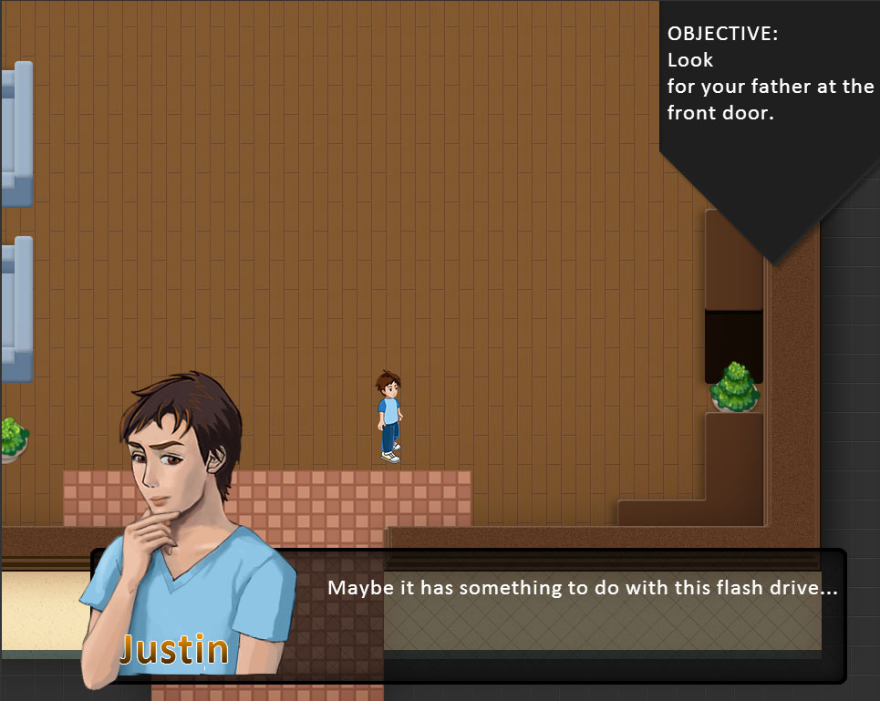
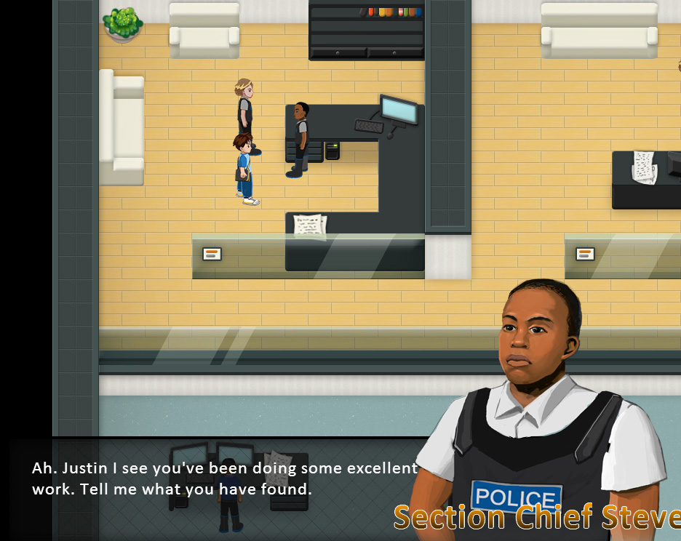

Slide 25
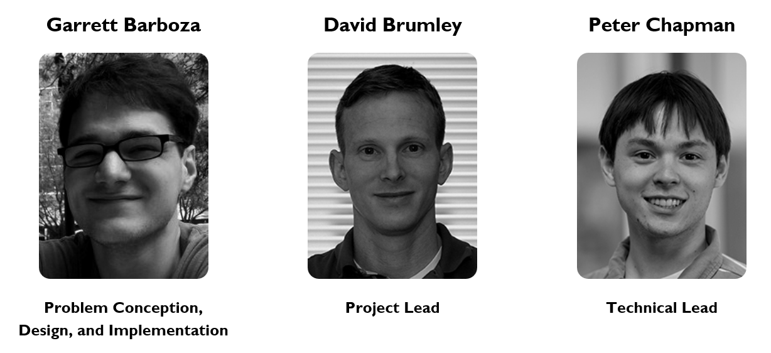
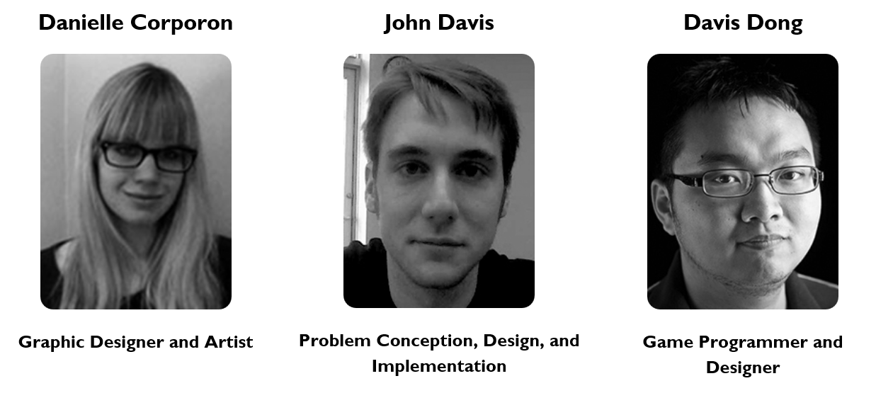
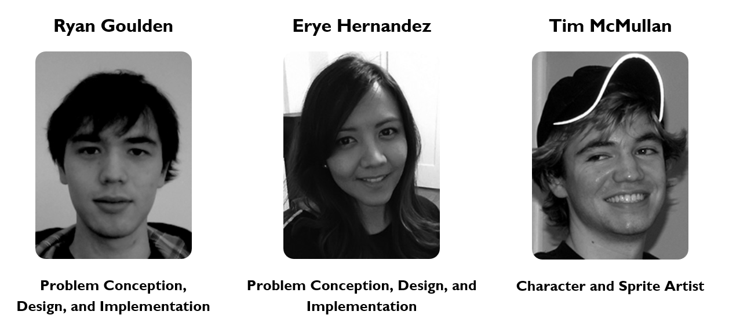
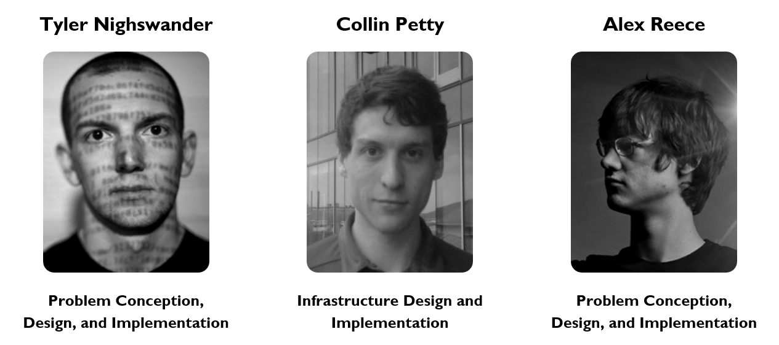
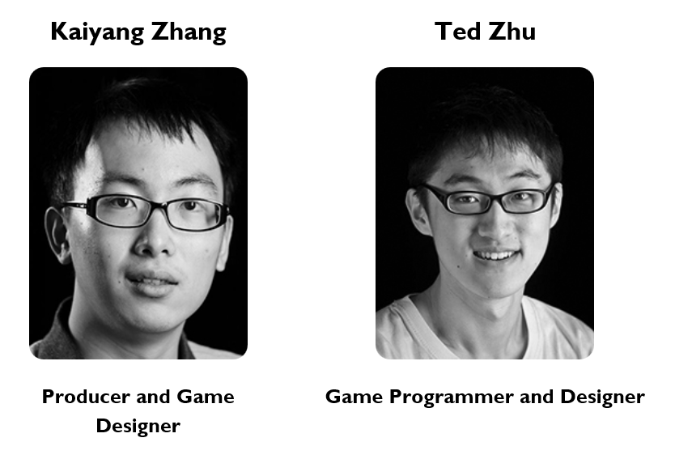
The Team

Slide 26









Sponsors

Slide 27
Questions??
picoctf.com
jburket@cmu.edu

