Slide 1
Automatic Problem Generation for Capture-the-Flag Competitions
Jonathan Burket
jburket@cmu.edu
Peter Chapman
peter@cmu.edu
Tim Becker
tjbecker@cmu.edu
Chris Ganas
cganas@cmu.edu
David Brumley
dbrumley@cmu.edu
Carnegie Mellon University
This material is based upon work supported
by the National Science Foundation under Grant
No. 1419362 and by a Graduate Research Fellowship
under Grant No. 0946825.
8/11/2015

Slide 2
Outline
Overview of Automatic Problem Generation
Flag Sharing in picoCTF 2014
Future Work

Slide 3
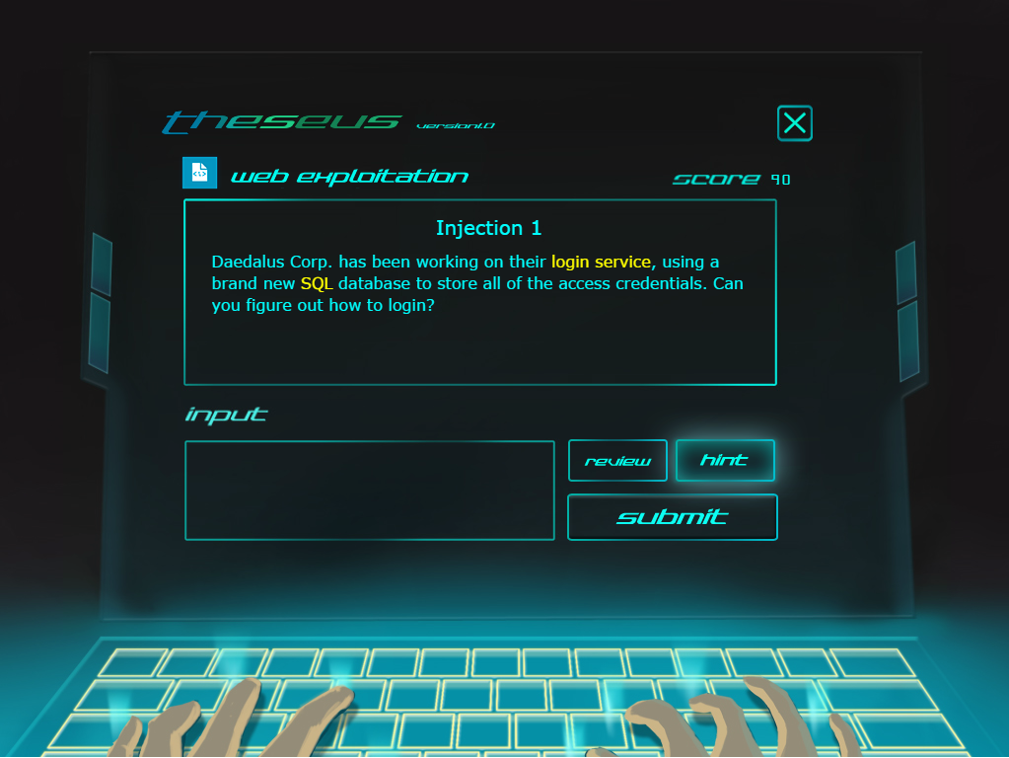
“Jeopardy-Style” Capture-the-Flag
Cryptography 100
Points!
Cryptography 200
Web
100
Web
200
Flag:
“sql_injection_rox”
Forensics
100

Slide 4
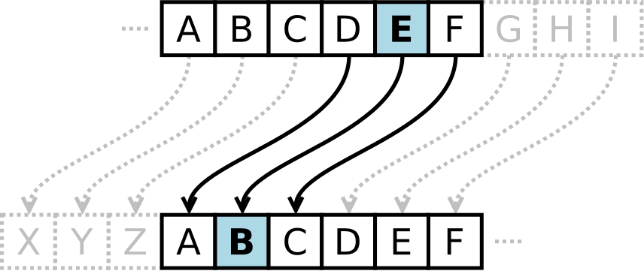
Example CTF Problem
You find an encrypted message written on the documents. Can you decrypt it?
“rfc qcapcr nyqqnfpyqc gq bmuasiugssaxxlextkasoklntcidhm”
“the secret passphrase is dowcukwiuuczzngzvmcuqmnpvekfjo”

Slide 5

Flag Sharing
Points!
Flag:
“sql_injection_rox”
Alice
Bob
Points!

Slide 6
Flag Sharing
Points!
Flag:
“sql_injection_rox”
Alice
freeflags.com
Points!
Points!
Points!
Bob
Carol
Dave

Slide 7
Changing Problems Automatically
“the secret passphrase is dowcukwiuuczzngzvmcuqmnpvekfjo”
“rfc qcapcr nyqqnfpyqc gq bmuasiugssaxxlextkasoklntcidhm”
k=24
“the secret passphrase is vrsoblzffauncgrgknleuxedsknnhb”
“rfc qcapcr nyqqnfpyqc gq tpqmzjxddyslaepeiljcsvcbqillfz”
k=24

Slide 8
Changing Problems Automatically
“the secret passphrase is dowcukwiuuczzngzvmcuqmnpvekfjo”
“rfc qcapcr nyqqnfpyqc gq bmuasiugssaxxlextkasoklntcidhm”
k=24
“the secret passphrase is dowcukwiuuczzngzvmcuqmnpvekfjo”
“znk ykixkz vgyyvnxgyk oy juciaqcoaaifftmfbsiawstvbkqlpu”
k=6
These different versions can be generated automatically!

Slide 9
Automatic Problem Generation
Through Automatic Problem Generation, different competitors can receive different versions (“autogen” problem instances) of a given problem.
“wkh vhfuhw sdvvskudvh lv yuvreociidxqfjujnqohxahgvnqqke”
Flag:
“vrsoblzffauncgrgknleux…”
Alice
Flags can’t be shared!
“rfc qcapcr nyqqnfpyqc gq bmuasiugssaxxlextkasoklntcidhm”
Flag:
“dowcukwiuuczzngzvmc…”
Bob

Slide 10
Templated Autogen Problems
“What is the value of {register} after executing the instruction at address {memory address}?”
“What is the value of eax after executing the instruction at address 0x12345678?”
“What is the value of ebx after executing the instruction at address 0x20202020?”
Problem instances are essentially the same,
but have slightly different details.
Good for detection and prevention of flag sharing

Slide 11
Flag:
“vrsoblzffauncgrgknleux…”
Correct!
Alice
Correct Flag:
“vrsoblzff…”
Flag:
“vrsoblzffauncgrgknleux…”
Flag Sharing!
Bob
Correct Flag:
“dowcukwiu…”
We detect flag sharing by looking for cases where users submit incorrect flags that are correct for an instance other than their own

Slide 12
Alice
Correct Flag:
“vrsoblzff…”
freeflags.com
“The correct flag for this problem is
vrsoblzffauncgrgknleux…”
Bob
Correct Flag:
“dowcukwiu…”
Distinct, per instance flags allows competition to detect the source of shared flags

Slide 13
Challenges
Balanced Difficulty
Bug Prevention
Scalability and Deployment

Slide 14
Balanced Problem Difficulty
“the secret passphrase is dowcukwiuuczzngzvmcuqmnpvekfjo”
k=0
“the secret passphrase is dowcukwiuuczzngzvmcuqmnpvekfjo”
Need to make sure each problem instance is reasonably close to the same difficulty.

Slide 15
Scalability and Deployment
Each team must be given a team-specific problem instance
Problem instance generation must not bottleneck the performance of the competition
For problems served from remote machines, instances must be deployed to those machines and synchronized with the grading server

Slide 16
Automatic Problem Generation in picoCTF 2014

Slide 17

picoCTF 2014
3,185 Eligible Teams
9,738 Eligible Students
12 Day Competition
66 Security Challenges
Cash Prizes for Top 10 Teams

Slide 18
Automatically Generated Problems in picoCTF 2014
Problem Name | Category | Score | Teams Solved
Tyrannosaurus Hex | Miscellaneous | 10 | 3185
No Comment | Web | 20 | 2952
Caesar | Cryptography | 20 | 2648
Internet Inspection | Web | 30 | 2704
Javascrypt | Web | 40 | 1719
Substitution | Cryptography | 50 | 1677
ZOR | Cryptography | 50 | 554
Basic ASM | Reversing | 60 | 887
Repeated XOR | Cryptography | 70 | 182
Block | Cryptography | 130 | 35

Slide 19
Flag Sharing in picoCTF 2014
127,412 flags (correct and incorrect) submitted to automatically generated problems
1,081 (0.84%) labeled as “shared flags”
530 distinct flag sharing cases
14% (460/3185) of teams involved
87% of these teams shared flags for only one problem
68% teams attempting to submit a shared flag eventually solved the problem correctly

Slide 24
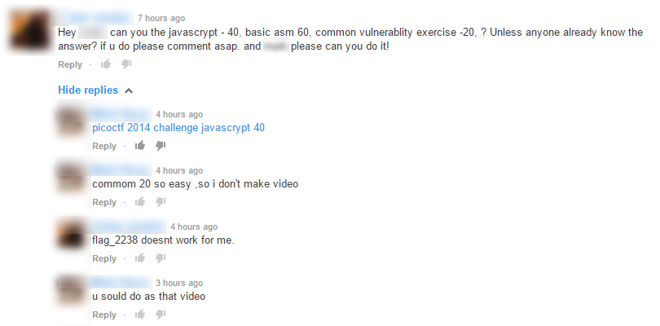

Slide 28
Future of Automatic Problem Generation in CTFs

Slide 29
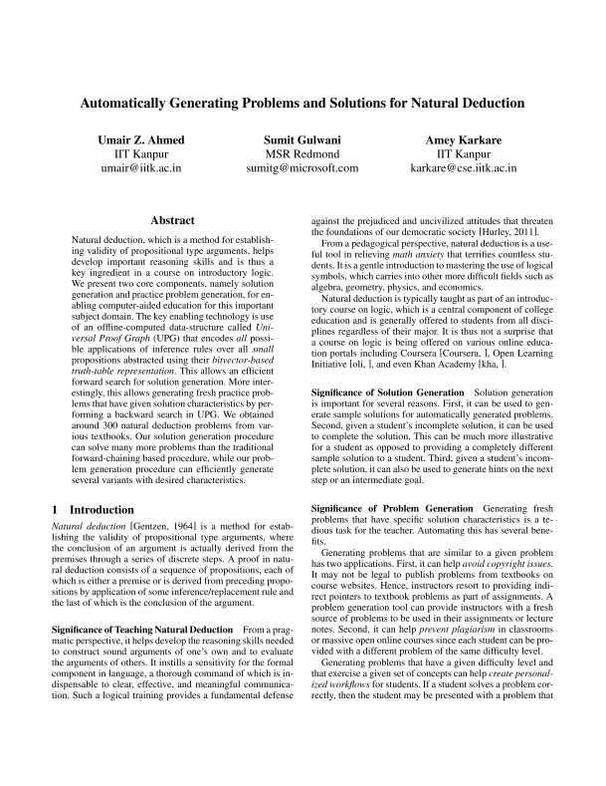
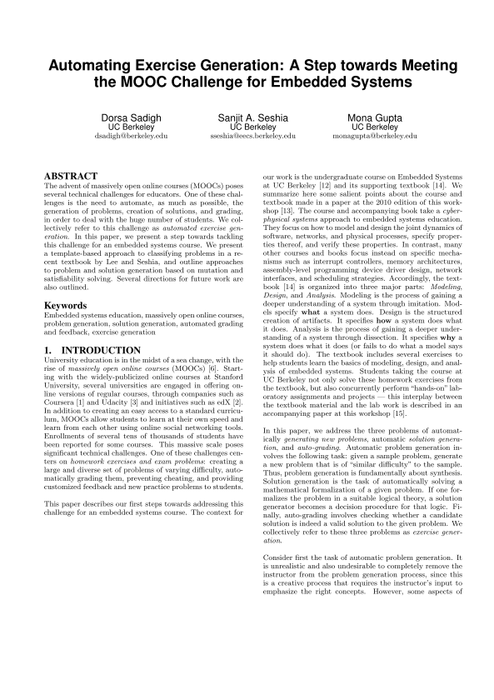
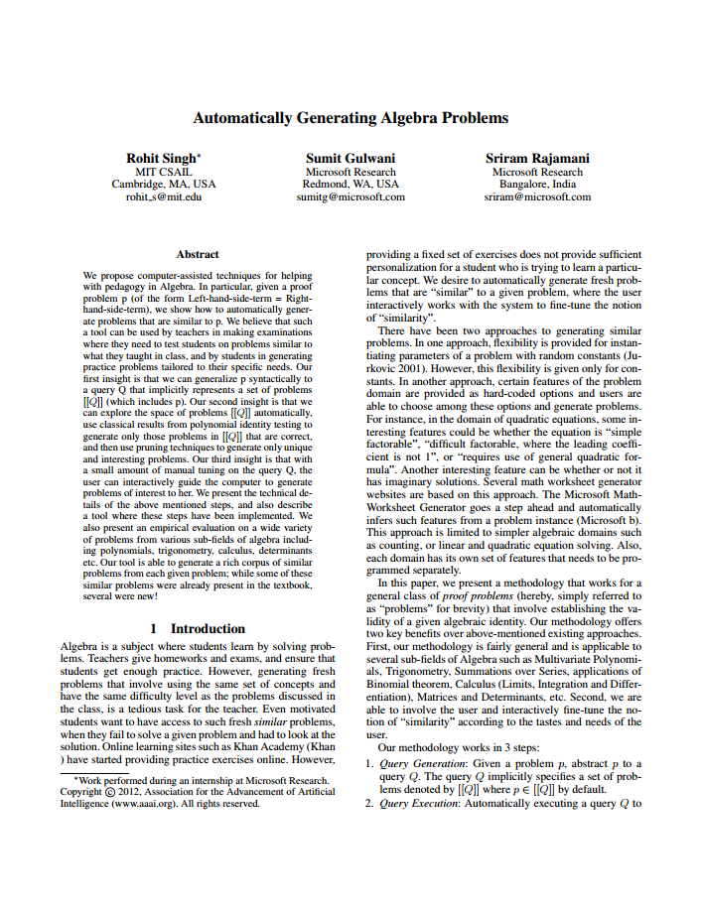
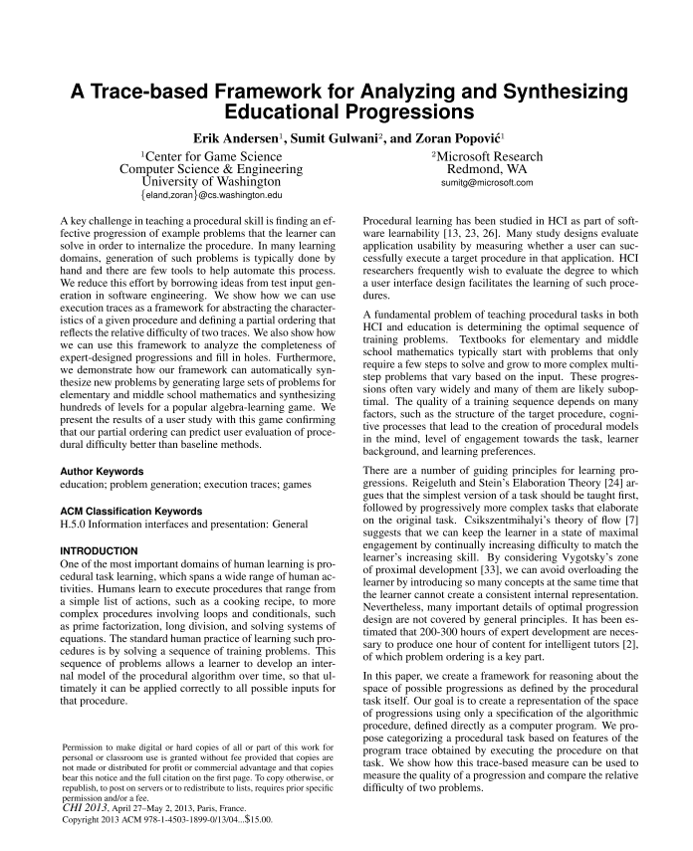
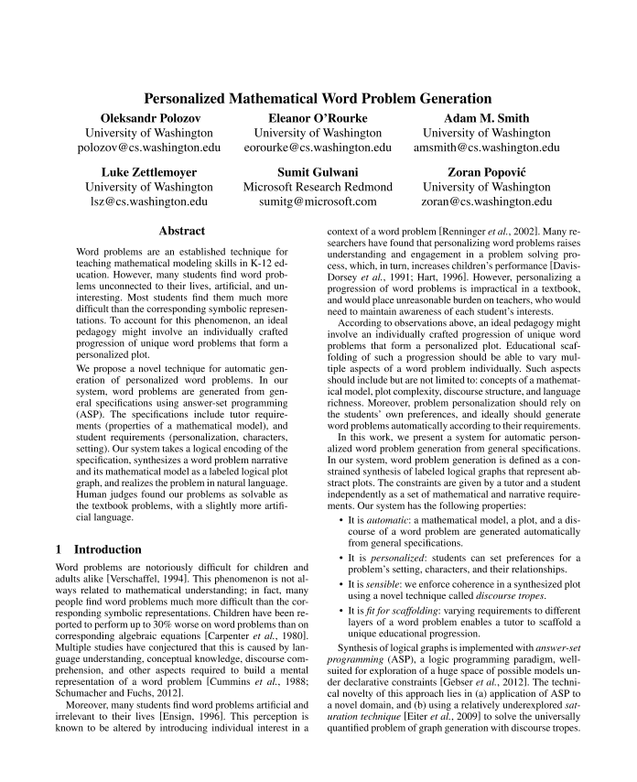

Slide 30
Synthesized Autogen Problems
void check_input(int v0, int v1) {
v0 += 7;
int v2 = 0;
v0 *= v2;
v1 += 2;
if(v0 < 45) {
int v3 = v0;
v2 -= v3;
}
v1 *= 8;
int v4 = 3;
v4 *= v1;
if(v0 != 0) {
you_lose();
return;
}
if(v2 != 0) {
you_lose();
return;
}
if(v4 != -456) {
you_lose();
return;
}
get_key();
return;
}
void check_input(int v0, int v1, int v2, int v3, int v4, int v5, int v6) {
int v7 = -1;
v3 -= 3;
v6 -= 1;
for(int v8=1; v8<= 9; v8+=v1) {
v5 += v8;
v2 *= v6;
}
int v9 = 6;
int v10 = 0;
if(v2 <= v9) {
v5 *= v4;
v0 += v3;
}
else {
v3 |= v6;
}
int v11 = v6;
v11 += v10;
for(int v12=1; v12< 10; v12+=v5) {
int v13 = v7;
v6 *= v0;
if(v5 == 44) {
v13 -= v2;
v11 *= v10;
}
else {
v13 *= v11;
…
void check_input(int v0, int v1) {
int v2 = v1;
int v3 = v0;
if(v1 > 29) {
v0 *= v1;
}
if(v0 != -8930) {
you_lose();
return;
}
if(v2 != 94) {
you_lose();
return;
}
if(v3 != -95) {
you_lose();
return;
}
get_key();
return;
}
Harder
Similar Difficulty

Slide 31

Synthesized Autogen Problems
Hard
Easy

Slide 32
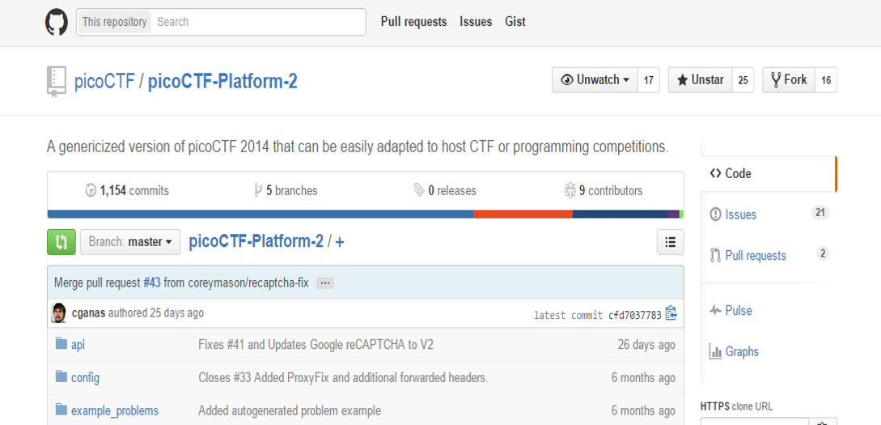
Questions?
https://github.com/picoCTF/picoCTF-Platform-2

